Slide 1
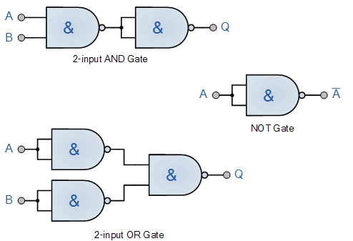
Logic Gates
LO: To understand how to write Boolean equations for logic circuits
Review of prep - Replicating logic gates using just a NAND gate

Slide 2
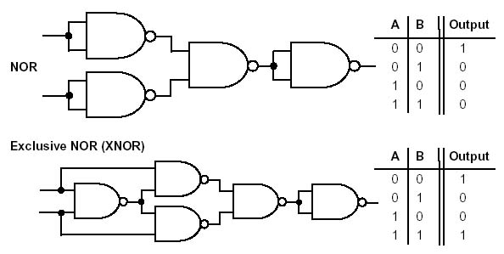
Logic Gates
LO: To understand how to write Boolean equations for logic circuits
Review of prep - Replicating logic gates using just a NAND gate

Slide 3
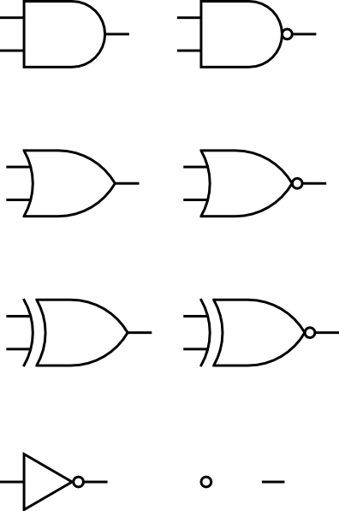
Logic Gates
LO: To understand how to write Boolean equations for logic circuits
Boolean expressions for Logic gates / circuits
As well as using the symbols to represent Boolean logic, equations can be used.
Symbol
Equation
Symbol
Equation
Symbol
Equation
A.B
A.B
A B
A+B
A B
A
A+B

Slide 4
Logic Gates
LO: To understand how to write Boolean equations for logic circuits
Logic circuit & Truth Tables
For example: Q = (A+B).C and represented in the following logic diagram with the corresponding truth table:

Slide 5
Logic Gates
LO: To understand how to write Boolean equations for logic circuits
Write the boolean expressions for each of these logic circuits
A
A
B
B
C
C
D
D
X = (A.B) . (C+D)
X = (A+B) + (C.D)

Slide 6
Logic Gates
LO: To understand how to write Boolean equations for logic circuits
Write the boolean expressions for each of these logic circuits
A
A
B
B
C
C
D
D
X = (A.B) . (C D)
X = (A+B) . (C.D)

Slide 7
Logic Gates
LO: To understand how to write Boolean equations for logic circuits
Task
Draw three logic gate circuits and then write the boolean expressions for them

Slide 8
Logic Gates
LO: To understand how to write Boolean equations for logic circuits
Task
Write three Boolean expressions and then draw the logic gate circuits for them

Slide 9
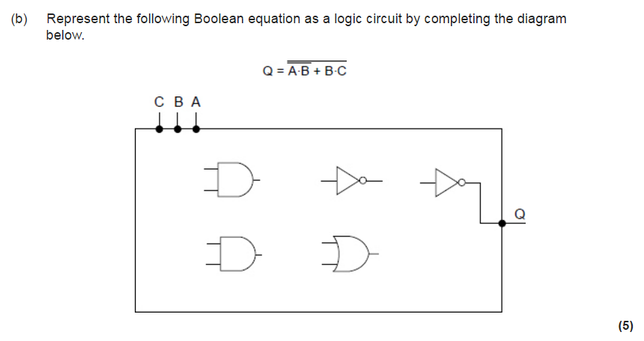
Logic Gates
LO: To understand how to write Boolean equations for logic circuits
Exam Questions

Slide 10
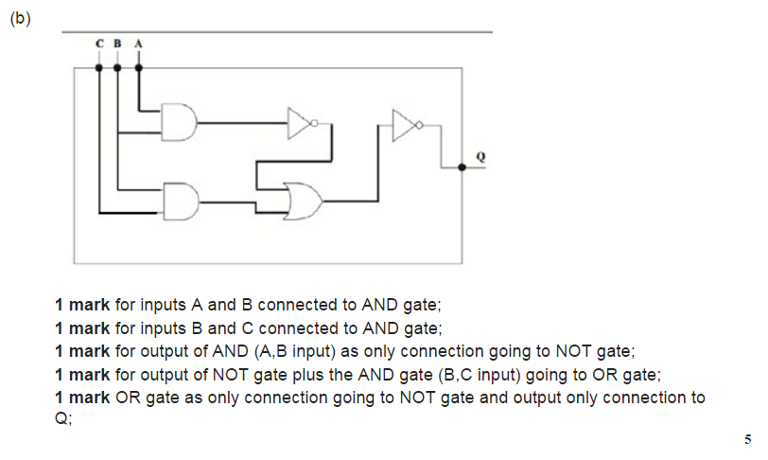
Logic Gates
LO: To understand how to write Boolean equations for logic circuits
Exam Questions

Slide 11
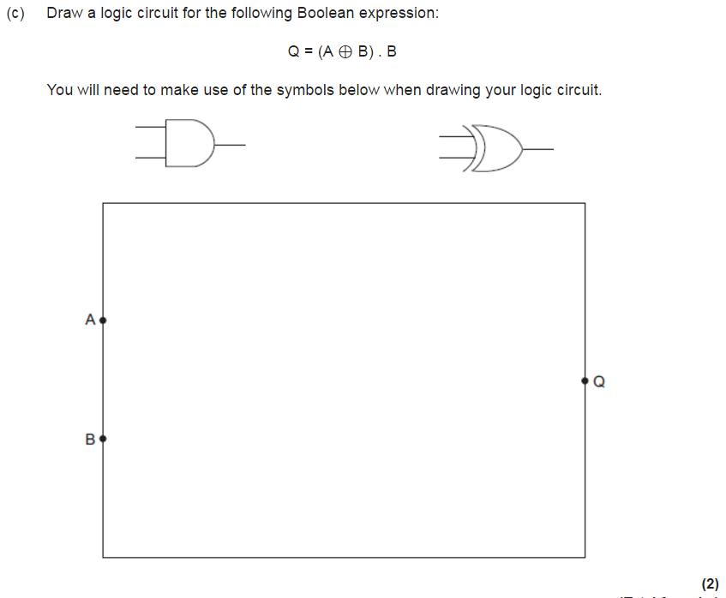
Logic Gates
LO: To understand how to write Boolean equations for logic circuits
Exam Questions

Slide 12
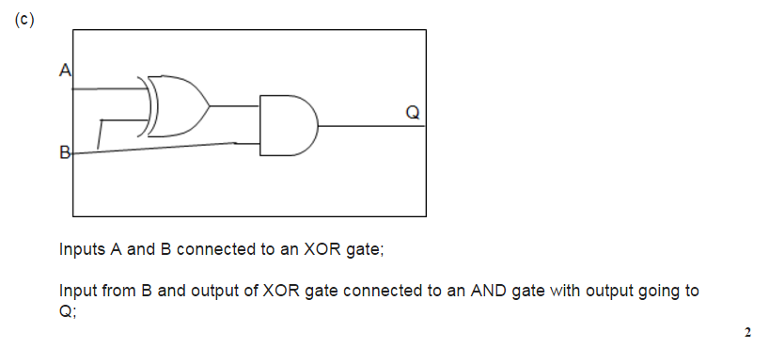
Logic Gates
LO: To understand how to write Boolean equations for logic circuits
Exam Questions

Slide 13
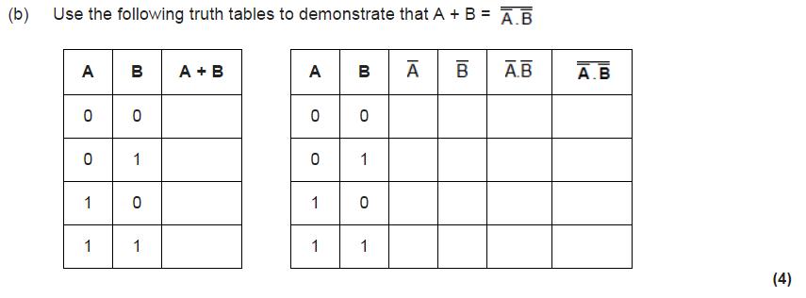
Logic Gates
LO: To understand how to write Boolean equations for logic circuits
Exam Questions

Slide 14
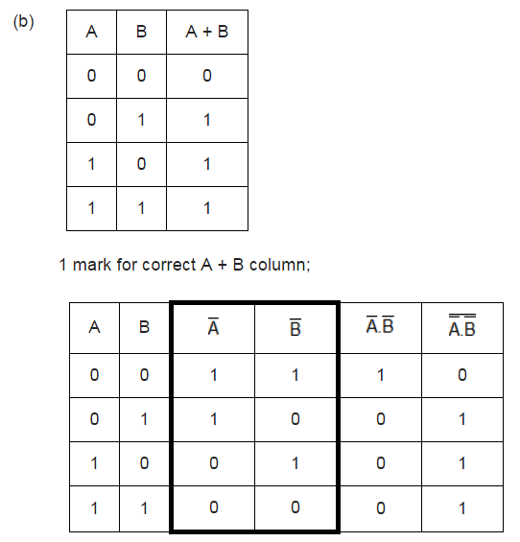
Logic Gates
LO: To understand how to write Boolean equations for logic circuits
Exam Questions

Slide 15
Logic Gates
LO: To understand how to write Boolean equations for logic circuits
Simplifying Boolean Expressions
When using Boolean expressions it is good practice to reduce the expression into its simplest form.
As Boolean algebra is used to create logic gates, simplifying the expressions also simplifies the actual circuit that will be built.
An expression may be made up of many variables, usually referenced as letters (A,B,C, etc.) each of which can produce a result of 0 or 1.
This can lead to the creation of complex Boolean expressions.
Therefore rules have been developed as a method of simplifying expressions.

Slide 16
Logic Gates
LO: To understand how to write Boolean equations for logic circuits
Simplifying Boolean Expressions - Rules
A.B = B.A | The order in which two variables are ANDed makes no difference
A+B = B+A | The order in which two variables are ORed makes no difference
A.0 = 0 | A variable ANDed with 0 equals 0
A+1 = 1 | A variable ORed with 1 equals 1
A+0 = A | A variable ORed with 0 equals the variable
A.1 = A | A variable ANDed with 1 equals the variable
A.A = A | A variable ANDed with itself equals the variable
A+A = A | A variable ORed with itself equals the variable
A.Ā = 0 | A variable ANDed with its inverse equals 0

Slide 17
Logic Gates
LO: To understand how to write Boolean equations for logic circuits
Homework
Draw truth tables to demonstrate that each of the rules on the previous slide are correct e.g.
A.0 = 0 A.1 = A
A | 0 | X
0 | 0 | 0
1 | 0 | 0
A | 1 | X
0 | 1 | 0
1 | 1 | 1

Slide 18
Logic Gates
LO: To understand how to write Boolean equations for logic circuits
Homework
Half Adder
The ‘Half Adder’ circuit that performs addition of two binary values
Output S stands for Sum
Output C stand for Carry
Research how a ‘Full adder’ works

Slide 19





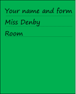









Key words:
Noted clearly
Topic specific vocabulary wherever necessary
Icon for extension activity if appropriate
Icon same colour as dept ex book
You might want to develop subject specific icons

